Slide 1

SAMHSA Structure/
Developing A Competitive
SAMHSA Grant Application
CAPT Emily Williams, LCSW-PIP
Regional Administrator, Region 9
Substance Abuse and Mental Health Services Administration
U.S. Department of Health and Human Services

Slide 2
Substance Abuse and Mental Health Services Administration (SAMHSA)
Mission
Reduce the impact of substance use and mental illness on America’s communities
Behavioral Health is
Essential to Health
Prevention Works
Treatment Is Effective
People Recover

Slide 3

SAMHSA Funding Opportunities
Grant Announcements

Slide 4
Overview of SAMHSA Discretionary Grant Programs
  Mental Health
  Suicide prevention, integrated care, children’s mental health, peer support services, treatment for children with Serious Emotional Disturbances (SED), adults with Serious Mental Illness (SMI), homelessness, supported employment, services addressing trauma, and training/technical assistance
  Substance Abuse Prevention
  Prevention of underage drinking, substance use, and HIV, harm reduction
Substance Abuse Treatment
  Drug courts (adult, family, tribal), offender re-entry, recovery support services, homelessness, treatment for substance use (SUD) and/or co-occurring disorders (COD), including residential treatment for pregnant/postpartum women, treatment for opioid overdose and opioid abuse, and training/technical assistance

Slide 5
The Notice of Funding Opportunity
SAMHSA announces grants through Notice of Funding Opportunities (NOFOs). A listing of all fiscal year 2024 NOFOs can be found at:
  https://www.samhsa.gov/grants/grant-announcements-2024
Sign up to receive SAMHSA NOFOs directly - click on this link on the FY 2025 Grant Announcements webpage
  Sign Up for Email Updates about Grant Funding Announcements
Except in cases where grants addressing urgent issues are announced, all grants are open for 60 days.

Slide 6
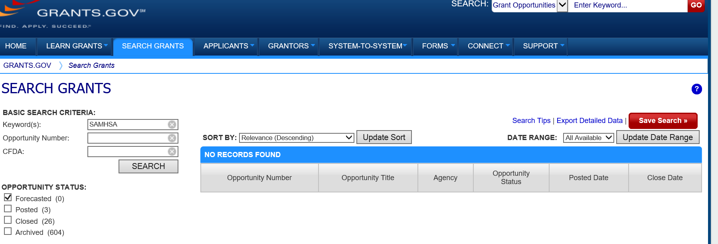
Grants.gov Forecast
On the grants.gov website, SAMHSA posts information about grants that will be announced in upcoming months. Click on the tab for Search Grants at the top of the main grants.gov webpage. Put a check in the Forecasted box and enter Keyword of SAMHSA.

Slide 7

Factors to Consider in Applying for Grants
Eligibility:
  Domestic public and private non-profit entities
  States/tribes/territories
  States/tribes/territories/local governments
  Limited eligibility, such as:
      Institutes of higher education
      Professional organizations
      Nonprofit hospitals or emergency
      departments
      Recovery Community Organizations

Slide 8
Factors to Consider in Applying for Grants (cont.)
Take note of the Required Activities and evaluate whether your organization has the capacity to implement the activities.
  Required Activities: National Child Traumatic Stress Initiative- Category III (SM-20-005)
  Service delivery must begin by the fourth month of the project.
  Recipients must use SAMHSA’s services grant funds primarily to support direct services. This includes the following activities:
  Provide outreach and other engagement strategies to increase participation in, and access to, trauma treatment and services; and prevention services for children and adolescents, and their families who have experienced traumatic events.
  Provide direct evidence-based mental disorder treatment and services (including screening, assessment, care management, therapy, and prevention) for diverse and at-risk children and adolescents. Treatment must be provided in outpatient, day treatment (including outreach-based services) or intensive outpatient, home-based or residential programs.
  Provide services to populations of child-serving service systems, such as child welfare, child protective services, law enforcement and courts, and the juvenile justice system, on trauma-informed practices using the grantee’s own expertise or Network resources at the local, regional, or state levels.
  Collaborate with NCTSI - Category II Treatment and Service Adaptation (TSA) centers to develop, advance, or adapt interventions to improve engagement and outcomes for traumatized youth.
  Implement a project evaluation including process and outcomes evaluation to be submitted to SAMHSA by the end of the project period.

Slide 9

Preparing to Apply for a SAMHSA Grant

Slide 10

Manual on Developing a Competitive SAMHSA Grant Application
A valuable resources is available on the SAMHSA website - Developing a Competitive Grant Application - which can be found at:
https://www.samhsa.gov/grants/grants-training-materials

Slide 11

Gathering Information/Data
In general, have organizational materials, such as job descriptions, policies and procedures (P&P) up-to-date (such as P&P related to financial management): https://www.samhsa.gov/grants/grants-management/policies-regulations)
Seek out data on substance use and/or mental health issues impacting your community
If your community does not have data on behavioral health issues available, reach out to other sources, such as the state agency responsible for behavioral health services or visit the
SAMHSA website -
https://www.samhsa.gov/data/

Slide 12

Gathering Information/Data (cont’d)
Identify opportunities for gathering information on the extent of need/service gaps in your community
Engage community leaders, network with other agencies in the community, and/or form a consortia with other communities who share similar behavioral health concerns

Slide 13

Applying for a SAMHSA Grant

Slide 14

Basic Application Requirements
  Completing four registration processes
  Responding to the evaluation criteria (Project Narrative – 10-page limit)
  Completing a budget and budget narrative
  Completing specific forms (SF-424, SF-424A, HHS Form 690)
  Submitting required attachments (job descriptions, resumes, Letters of Commitment, data collection instruments, consent forms, documentation of non-profit status)

Slide 15

Registration Processes
Get started immediately to complete the four parts of the registration process:
Dun and Bradstreet Number (DUNS)*
Grants.gov
System for Award Management (SAM)
(make sure your SAM registration is up-to-date – it must be renewed
every year)
4. eRA Commons
*DUNS numbers will be phased out by April 2022 and replaced by a Unique Identifier ID.

Slide 16

Develop a Work Plan
Develop a work plan and identify staff who will be responsible for different tasks (see Appendix D in manual)
Identify who will be served in your community by the grant (i.e., youth and young adults)
Outline goals and measurable objectives

Slide 17
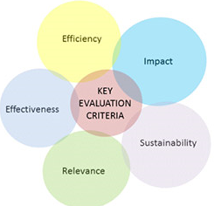
Responding to the Evaluation Criteria

Slide 18

Statement of Need
In your description of the statement of need, make sure you reference the most current data you have access to and provide citations in an Attachment.
If your catchment area is a local community, it is not sufficient to just cite national or state data, provide data specific to your community.

Slide 19

Goals and Measurable Objectives
Develop realistic goals and measurable objectives (guidance is in an appendix in the NOFO)
The goals and measurable objectives must align with the statement of need outlined in Section A.
Objectives must be linked to specific goals
Reference how you will collect data for the identified objectives in the section on data collection and performance measurement.

Slide 20

Implementing the Required Activities
Address all of the required activities – clearly delineate your response to each of the activities (you do not need to type in the full text of the activity)
Include sufficient detail (how, where, why, when, what, who)

Slide 21
Project Timeline
Develop a realistic timeline for the entire project period (not just the first year)
Keep it simple
Identify responsible staff, not the overall organization
Include requirements outlined in NOFO (starting services w/in 4 months, required activities, Disparities Impact Statement, needs assessment, data collection, submission of progress reports)
Look at examples in manual

Slide 22
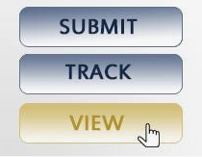
Submitting the Application
WARNING:
Do not wait until close to the deadline to submit your application – allow for extra time to address any submission errors.

Slide 23

Technical Assistance and Resources

Slide 24

Obtaining Copies of Funded Applications
It is possible to obtain copies of funded SAMHSA applications by submitting a Freedom of Information Act (FOIA) Request.
Information about submitting FOIA requests can be found at:
https://www.samhsa.gov/foia
In the FOIA request ask for 2-3 funded
applications from a previous year for a
specific Funding Opportunity
Announcement.

Slide 25
Useful Links
Dun and Bradstreet Number: http://www.dnb.com
System for Award Management (SAM): https://www.sam.gov
Grants.gov: http://www.grants.gov
eRA Commons:
https://public.era.nih.gov/commons/public/registration/registrationInstructions.jsp
Developing a Competitive SAMHSA Grant Application: https://www.samhsa.gov/grants/applying/forms-resources
Evidence-Based Practices Resource Center: https://www.samhsa.gov/ebp-resource-center
SAMHSA Data: https://www.samhsa.gov/data/

Slide 26
Thank You
SAMHSA’s mission is to reduce the impact of substance abuse and mental illness on America’s communities.
If you would like a copy of the slides, send an email to:
Emily.Williams@samhsa.hhs.gov
www.samhsa.gov
1-877-SAMHSA-7 (1-877-726-4727) ● 1-800-487-4889 (TDD)

